Slide 1
FAST Training
Gurumoorthy Ramasamy

Slide 2
Agenda
Week 1
Day 1 – FAST Architecture Overview
Day 2 –Business Objects
Day 3 – Hands-on training in BOs
Day 4 - GUI Framework
Day 5 – Hands-on training in GUI Framework.

Slide 3
Agenda (Contd…)
Week 2
Day 1 – Document Delivery and Imaging
Day 2 - .Net based architecture overview
Day 3 - .Net based application development
Day 4 – Hands –on training in .Net

Slide 4
Day 1- Fast Architecture Overview
Background
Architectural Tiers
Infrastructure
FAST Sub-systems
FAST Interfaces
Setting up the development environment

Slide 5
Background
Microsoft DNA Architecture
Project Started In Jan 1999
Web Application VS Client-Server
  Web-based is easier to deploy
  Technology moving to web-based

Slide 6
Background (Contd…)
Decision to use Microsoft DNA Solution
  Best choice at the time due to in-house expertise and best RAD tool-set
  Java was still emerging in 4 yrs ago
  Middle Tier in C++ & VB
  Client Side in Jscript and J++.

Slide 7
High level architecture
Business
Objects (BO)
GUI Page
SQL
Server
Database
Data
Access
Layer (DAL)

Slide 8
Business Objects (BO) Overview
Business Objects are tightly coupled to a record in the database
Record from the database is loaded and saved using Stored procedures
Stored procedures are the only allowed way to access the data from the database
All the database access is done only through Data Access Layer (DAL)

Slide 9
Data Access Layer (DAL) Overview
ADO is used to access the data
DAL is the Fast access to the database
Load and Save are the common terms used
ADO based transactions are used
ADO Connection pool is used

Slide 10
GUI Architecture
Business objects are used to get the data from the database
3 different architectures are available to access the business objects
  Client Business Object Manager (CBOM1) (Fast 1.x)
  CBOM2 (Fast 2.x)
  ASP Based Framework (Fast 2.x)
  .Net based architecture (Future)

Slide 11
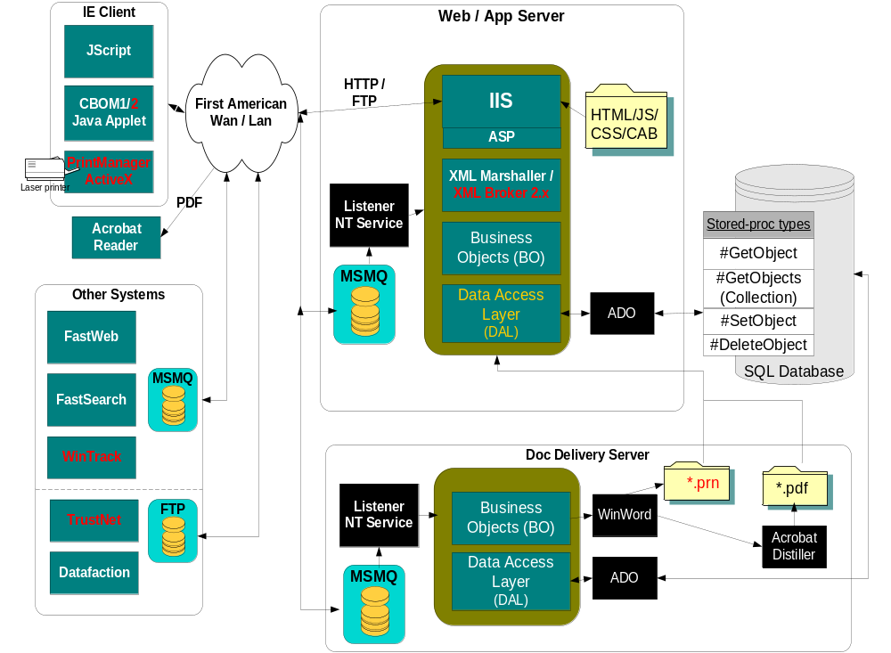
FAST Architecture

Slide 12
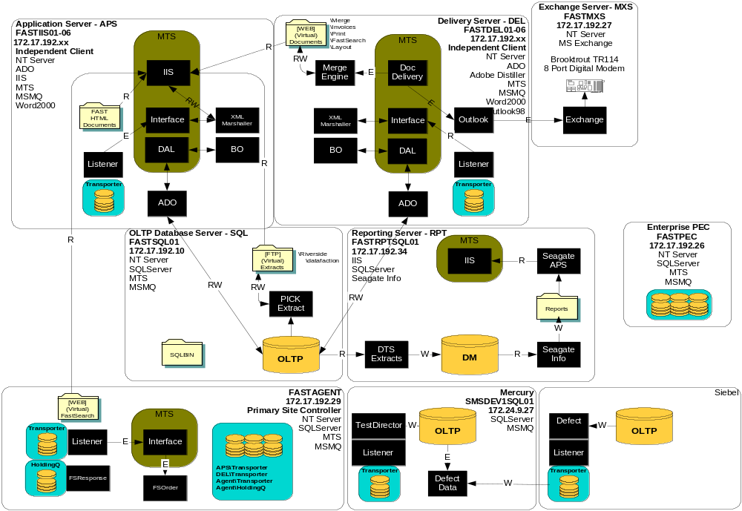
Current Infrastructure

Slide 13
FAST Tiers (Functionality Based)
File Management
  Order creation and maintenance
Escrow
  Charge processing
  Closing
Docprep and Delivery
  Document creation and maintenance
  Document generation and delivery
External Interface
  FastWeb (Internet)
  WinTrack (Legacy)
  FastSearch (Title search)

Slide 14
Setting up development Environment
Install the application and test
Create a Interdev project from http://localserver/FastMain_Web and test.
Get all the files from FastMain_Source, compile using Master.dsw and Autobuild

Slide 15
Install FAST application
Create FASTInstall.ini in C:\winnt folder (Sample is provided)
Install the application from the given location
Some important data to note
  Registry entry values in HKLM\SOFTWARE\SMS
    Connection String value Default_Connection from HKLM\SOFTWARE\SMS\FAST\DAL\
    Queuepathname from HKLM\SOFTWARE\SMS\DocumentDelivery
  Virtual Directories smsfast, XMLBroker2
    SMSFast is configured to have basic authentication
    XMLBroker2 is configured to have anonymous authentication
  Log files folder C:\CM\Logs

Slide 16
Create Interdev project
Select New Web Project from the New Project option
Set the location to D:\FastMain_Web
Type the server name as XXXX and select local mode
Select the default options and get all the files
Set Default.asp as your start Page
Browse Default.asp from Interdev
A new Web-Application is created in IIS.
Open IIS Manager and change the security settings
Now browse default.asp again.

Slide 17
Get all the BO related Files (for C++ developers)
Get all the files from Fast_Source
Install the custom Autobuild tool in Visual C++ as demonstrated
Setup the environment variables to find the vb.exe and devenv.exe
Compile the files using autobuild
Launch the application using the browser

Slide 18
Day 2 Agenda
Business Objects overview
Events available to override
BO Test Client and Generator
Sample usage
Sample usage code walkthrough
  Lot of Visual C++ code to look

Slide 19
Business Objects
BO Framework
All the objects are COM objects
Factory pattern is used to Create and Save objects
Every object has an id property and is used to load
All the objects are derived from BOBase class
All the objects are ATL based objects

Slide 20
Business Objects (Contd…)
Business Objects has member variables to store the property data
Data between the Recordset field and member variables are exchanged
Macros are heavily used
  To define property map
  To define sub object map
  To define collections

Slide 21
Business Objects (Typical usage)
Create the object using the Factory
  Load the recordset using load Stored Procedure
  Load the data from the recordset into the member variables
  Load subobjects
  Load collections
Cache the object

Slide 22
Business Objects (Typical usage)
Update the object with data and save
  Set the properties of the object
  Validate the data
  Create a recordset using the save Stored procedure’s metadata
  Load the data from the properties to the Recordset
  Call the Save Stored procedure to save the object

Slide 23
Object load events
Loaded using the Factory
LoadProperties
  Default implementation loads the data from the Recordset fields to the member variables using the property map
  Loads the subobjects
LoadChildren
  Default implementation loads the collection objects using the collection map

Slide 24
Object Save Events
BeforeSave
SaveSubObjects (As part of the same transaction)
Save the object using the Stored procedure
SaveChildren
SaveComplete

Slide 25
BO Generator / BO Test Client
Demo

Slide 26
Business Object typical usage
Code walkthrough

Slide 27
Day 3
Hands on exercise with BOs

Slide 28
BO Exercises
Compile the files and setup the environment
Create New object and save
Load an existing object and save
Make change to an object and test it

Slide 29
Day 4 Agenda
GUI Framework overview
Different ways of accessing the BOs
Jscript based Client controls
GUI Framework navigation
ASP Framework and server controls

Slide 30
Frames in the GUI Framework
MRU List
Top Frame for toolbar support
View frame (Actual Page) .
Left frame for Tree view support
The Main Application Frame
Status bar and framework buttons

Slide 31
GUI Framework overview
Frames based application framework
DHTML is used heavily.
Jscript is the default client side language.
Jscript controls are created and used in the system
App.htm is the main application page.

Slide 32
CBOM 1
Client Business Object Manager (CBOM) is an applet
One instance is created in every page
Proxy of the object is created in the client.
Object is cached on the server and the proxy is cached in the client for the life of the applet
XML is used to transfer the data between the client and server

Slide 33
CBOM 1 (Contd …)
ASP Page (DataAction.asp) and COM component (XMLMarshaller) is used on the server side to access the BOs.
XMLMarshaller instance is created on Session start and stored in the session
XMLMarshaller is a VB COM+
Component !?!?
Server BOM (SBOM) object is used to cache the object

Slide 34
CBOM 1 (Contd …)
A sample usage
var strBinding = "<OBJECT NAME='SMSBUSSOURCE.BusOrg' KEY ='10' ID=''ACTION='GET'> <ObjectCd</OBJECT>“;
CBOM.SetBinding("SMSBUSSOURCE.BusOrg",10,strBinding)
oBusOrg=CBOM.GetBo("SMSBUSSOURCE.BusOrg",10);
txtCode.value = oBusOrg.GetField(“ObjectCd”);
oBusOrg.SetField(“ObjectCd”, txtCode.value);
oBusOrg.Save();

Slide 35
CBOM 2
Client Business Object Manager 2 (CBOM) is also an applet
Only one instance is created for the entire application. This made global caching and sharing of objects possible
A context object is created for every page and is available for the page to use
Proxy of the object is created in the client.
Object is cached on the server and the proxy is cached in the client.

Slide 36
CBOM 2 (Contd …)
XML is used to transfer the data between the client and server
ISAPI extension dll (XMLBroker.dll) is used on the server side to create the BOs
XMLBroker has it’s own session management
XMLBroker is a multi-threaded dll created using C++
Microsoft XML Parser is used in CBOM2 for parsing XML and for posting request to the server

Slide 37
CBOM 2 (Contd …)
Sample Usage
try
{
var oAtt = document.BC.loadObject(“Attorney(‘1023’)”);
txtDeposit.value = oAtt.getString('EarnestDeposit‘);
oAtt.setValue('EarnestDeposit‘,txtDeposit.value);
oAtt.Save();
}
Catch(e)
{. . .
}

Slide 38
CBOM1 and CBOM2 usage
Code Walkthrough and Sample code

Slide 39
GUI Framework navigation
Framework buttons
Fully Qualified ID (FQID)
Child page
  showChild(childID,sURL)
  showParent(sURL)
AutoSave

Slide 40
GUI Framework events
IPage_Populate()
  Load event called after the page is loaded. Create the objects, dynamic controls and load the page.
IPage_Persist()
  Called when the Save button is clicked or AutoSave is triggered. Update the objects with data.
IPage_Validate()
  Called after IPage_Persist(). Do the validation of the data.
IPage_Save()
  Save the data
IPage_Done()
  Called when the done button is clicked
IPage_Unload()
  Release the objects

Slide 41
Jscript Controls
Created using DHTML
Dynamically created using JScript
Sample Controls
  GridView
  TabView
  Toolbar
  TreeView
  Calender
  Input
  Combo-Box

Slide 42
GridView
Grid control with dynamic row addition capability
Very Rich in functionality
Typically rows are added from the BO collection
Sample usage demo

Slide 43
Toolbar
Dynamically created
Individual buttons can be disabled
Supports click event
Sample usage demo

Slide 44
Input Controls
Supports formatting of data
Supports data validation and masking of data
Sample usage Demo

Slide 45
ASP based framework
One Visual Basic component created for every page
XML Bound data controls
  Grid Control
  Input
  Combo Box
Similar pattern is used in .Net based framework
Sample usage

Slide 46
Day 5
Hands on training in GUI Framework

Slide 47
Exercises
Create a simple page and create and update an object using CBOM1 and CBOM2
Create a page and add it to the tree view
Create a page using ASP based framework

Slide 48
Day 6
Doc Prep and Document Delivery Overview
Docprep Documents and System Documents
Check Printing overview
Delivery process explained
Imaging Architecture
Imaging System explained

Slide 49
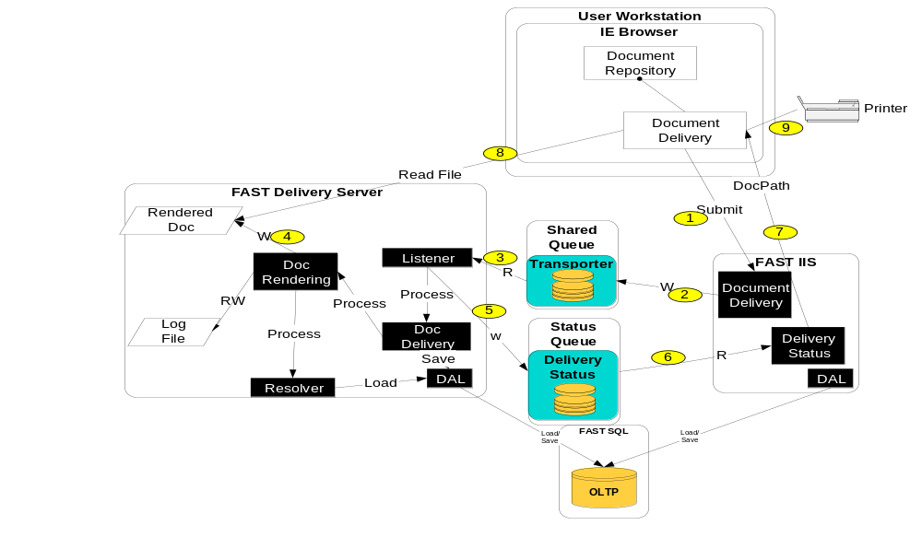
Document Delivery Architecture

Slide 50
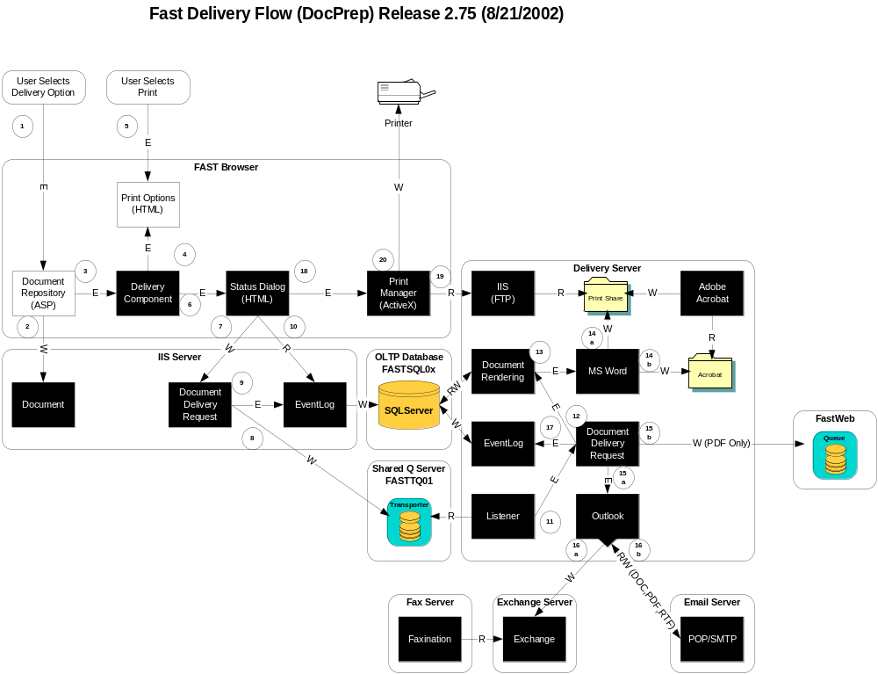
DocPrep Documents

Slide 51
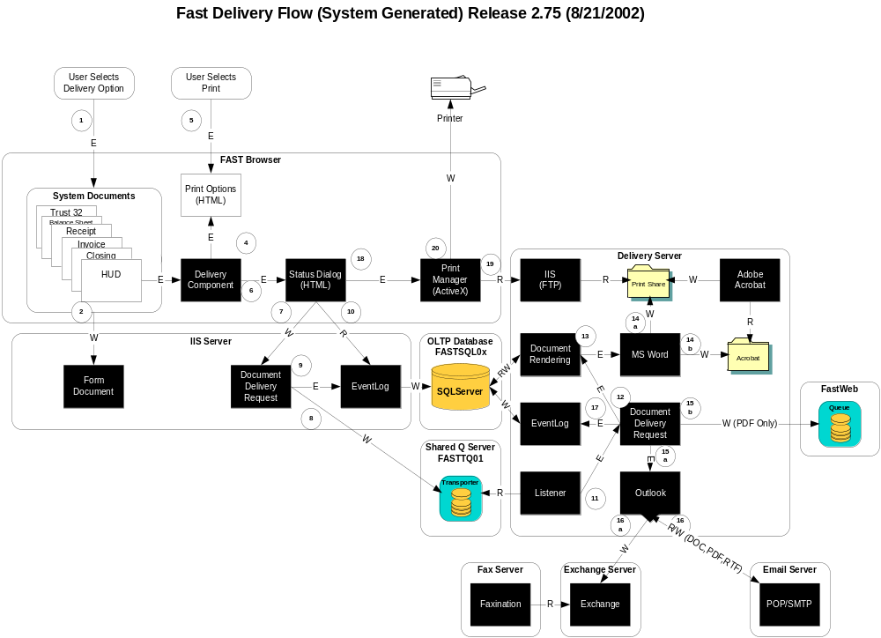

Slide 52
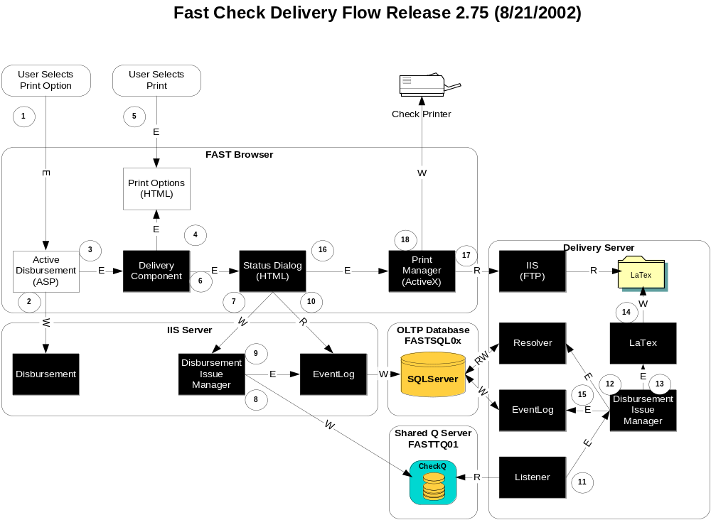

Slide 53
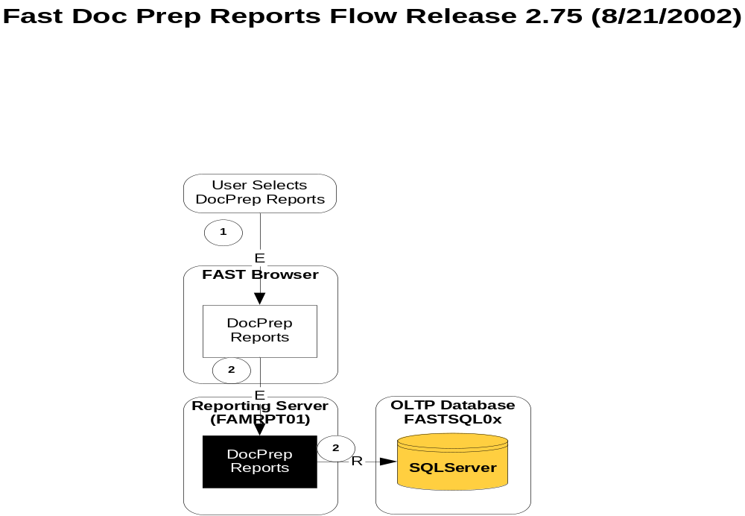

Slide 54
Doc Repository Usage
Documents are the deliverables
Different types of Documents
Doc Repository usage Demo

Slide 55
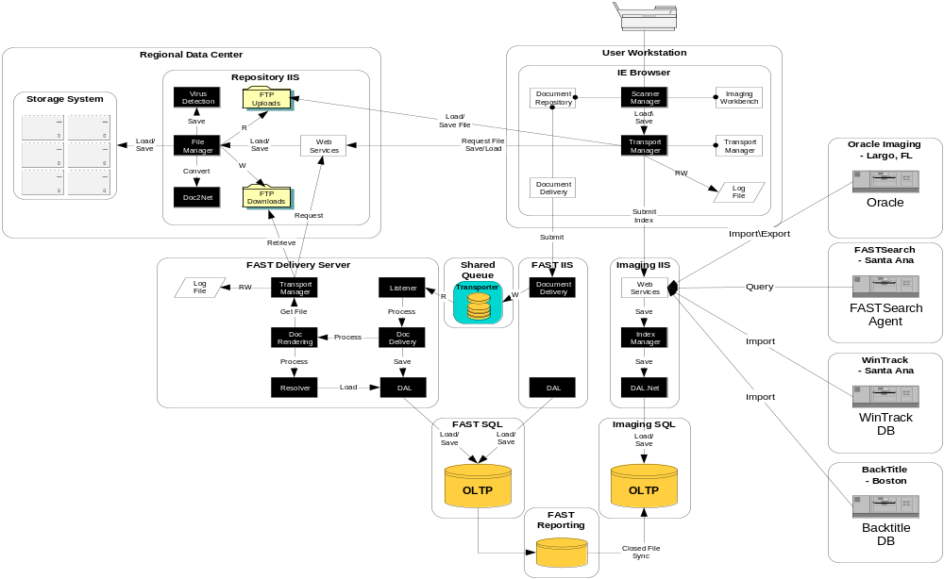
Imaging Architecture

Slide 56
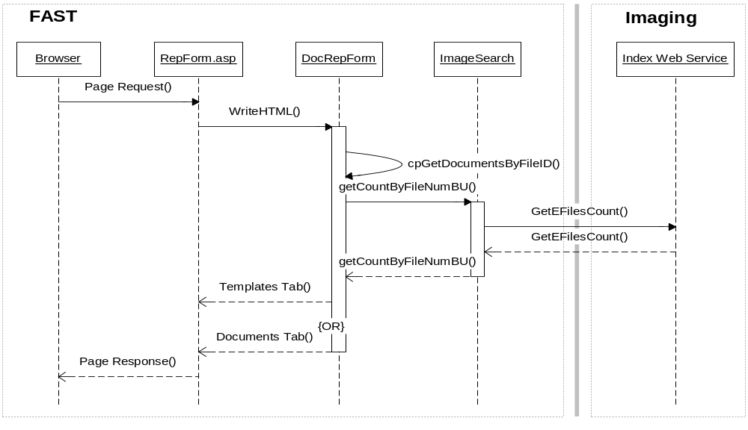
Doc Repository Initial Load

Slide 57
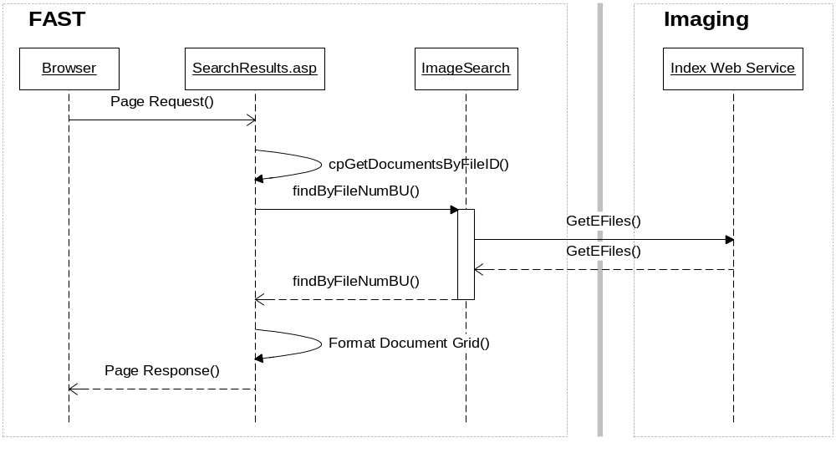
Display the Documents Tab with Documents and Images

Slide 58
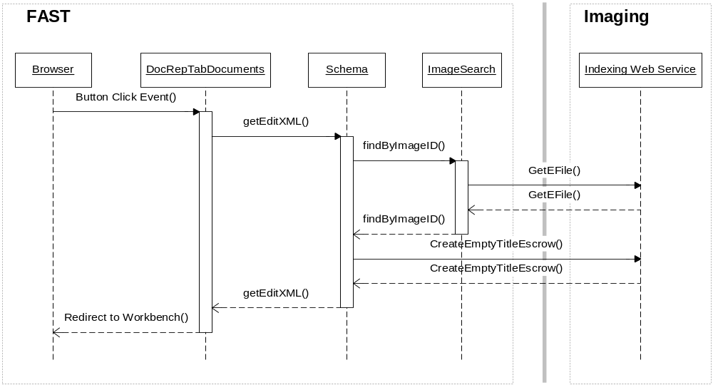
Edit an Image from Documents Tab

Slide 59
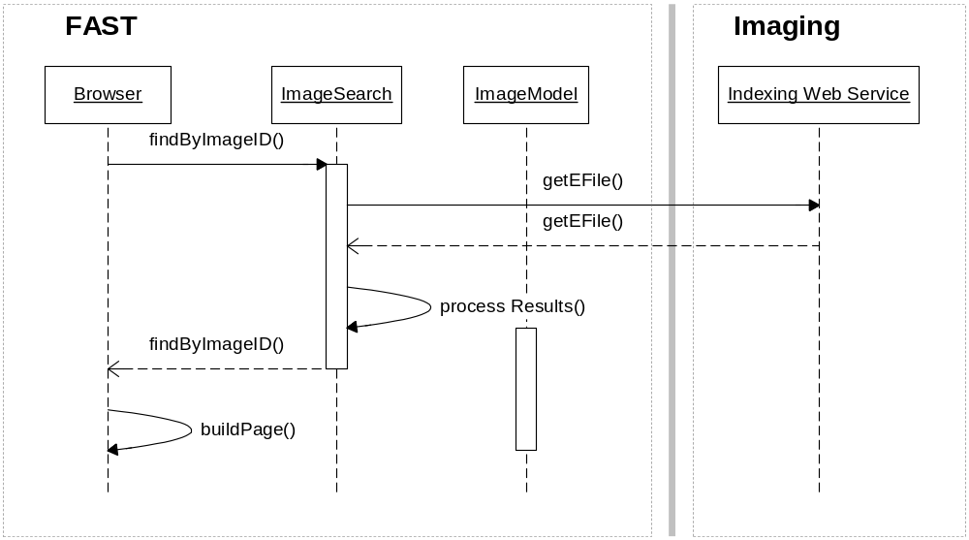
Display Image Detail Information

Slide 60
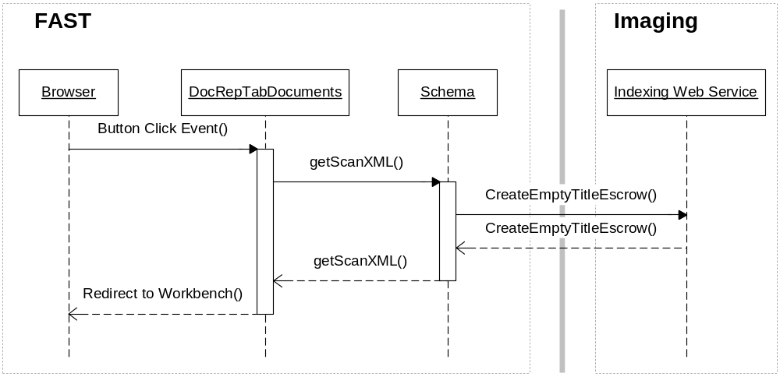
Scan a New Image

Slide 61
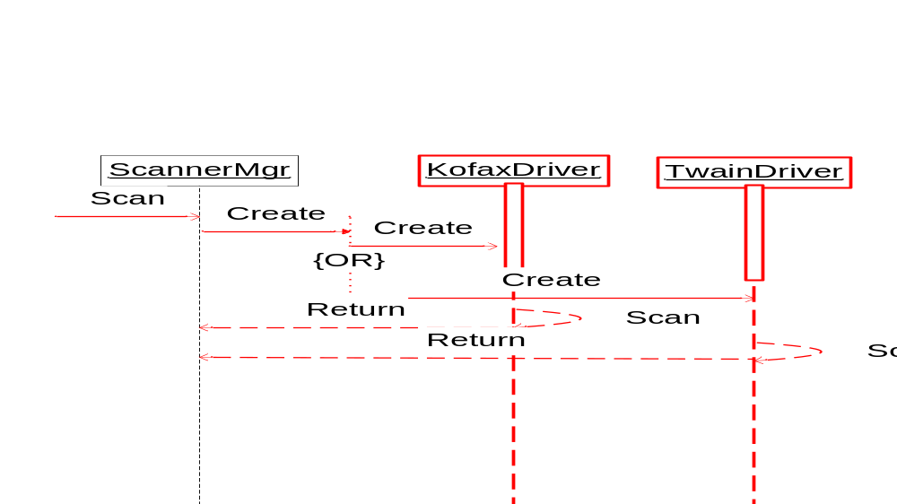
Scanner Manager

Slide 62
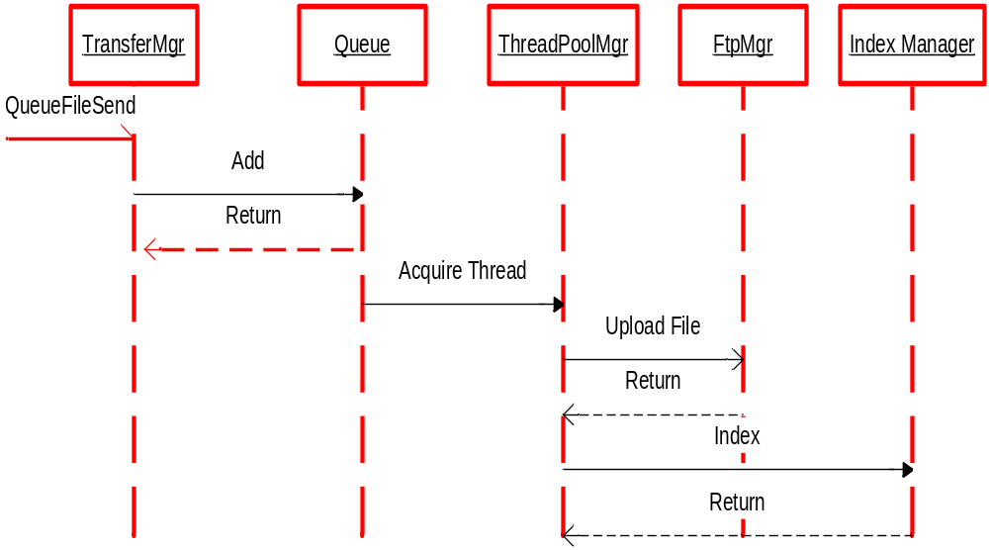
Transport Manager - Asynchronously uploading of a file

Slide 63
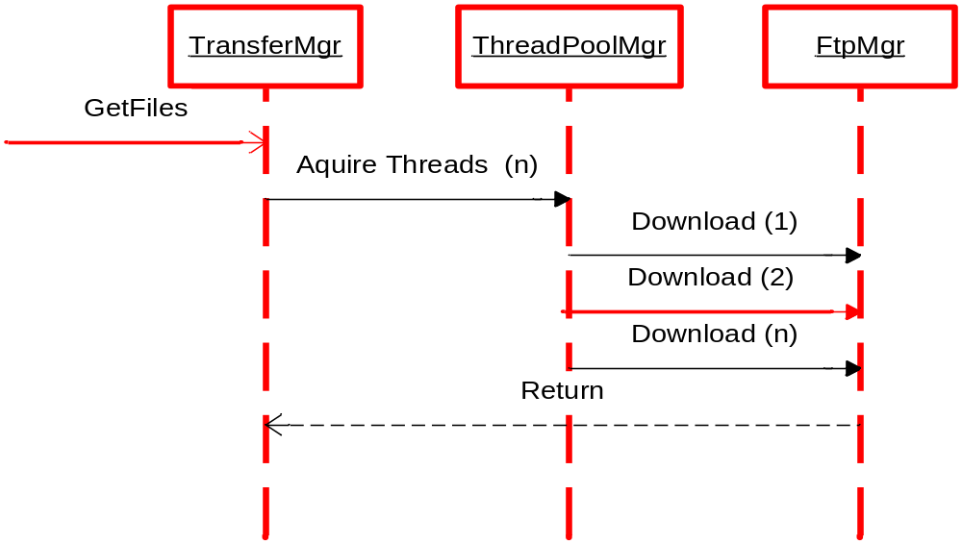
Transport Manager - Synchronously download of many files

Slide 64
